Slide 1
GENERICS

Slide 2
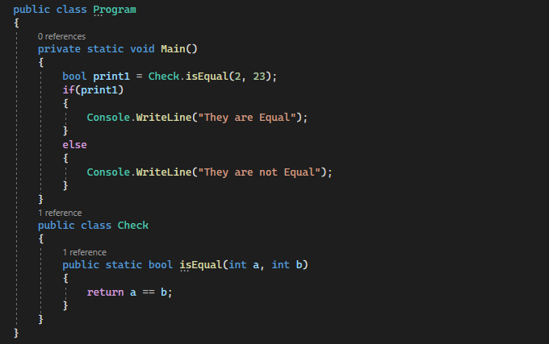

Why Generics
Let’s look at the above code it checks if two integers are equal or not . What will happen if I pass two strings and not integers?
Looks like we have a Problem .

Slide 3
The Problem
The Problem is the function at the moment is not dynamic , ( cannot take different datatypes) . Do we have a solution?
Yes
Use Object datatypes
Use Method Overloading
Generics
Let look at all.

Slide 4
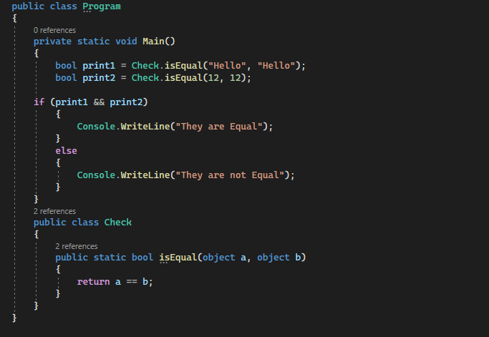
Object Datatype
The problem was solved but we have a new one objects are type unsafe

Slide 5
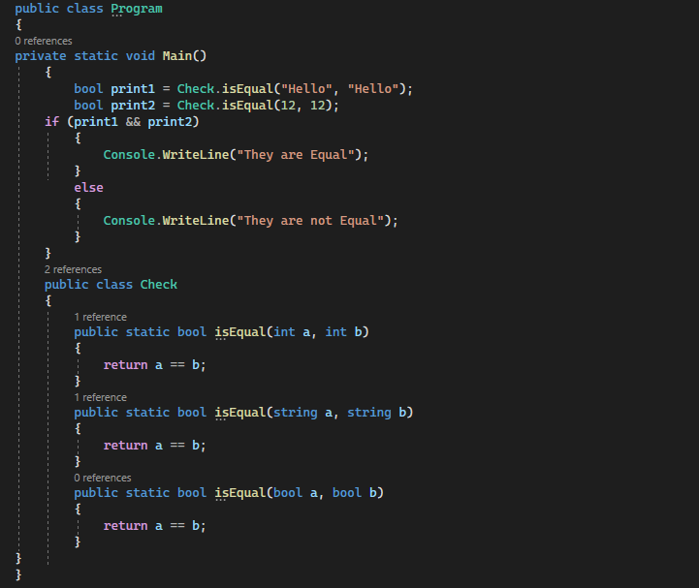
Method Overloading

Slide 6
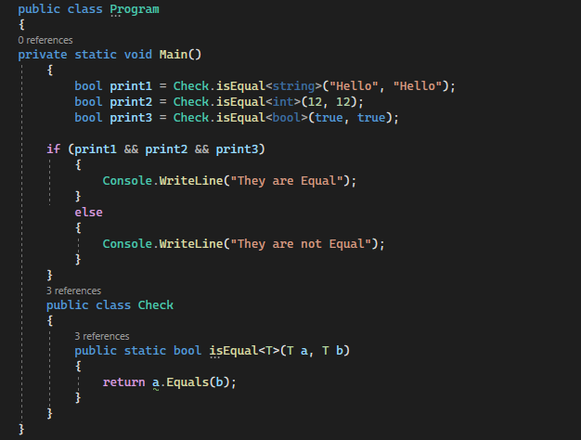
Is Method Overloading Okey ?
Yes , its okey but we are writing more code. But how can we solve this?
The problem is the code is not reusable ,The solutions is Generics. T below is generics.

Slide 7
Generics
The Generics allow us to define classes and methods which are decoupled from the data type. In other words, we can say that the Generics allow us to create classes using angular brackets specifying the data type of its members. At compilation time, these angular brackets are going to be replaced with some specific data types. In C#, the Generics can be applied to the following:
Interface
Abstract class
Class
Method
Static method
Property
Event
Delegates

Slide 8
Advantages of Generics
It Increases the Reusability of the Code: For example, you can create a generic method to add two numbers. This method can be used to add two integers as well as two float numbers without any modification to the code.
Generics are Type-Safe: Generics are type safety, especially in the case of collections. When using generics, we need to define the type of objects to be passed to a collection. This helps the compiler to ensure that only those object types that are defined in the definition can be passed to the collection. We will get the compile-time error if we try to use a different type of data rather than the one, we specified in the definition.
Generic Provides Better Performance: It gives better performance compared to non-Generics because they reduce the need for boxing, unboxing, and typecasting of variables or objects.

Slide 9
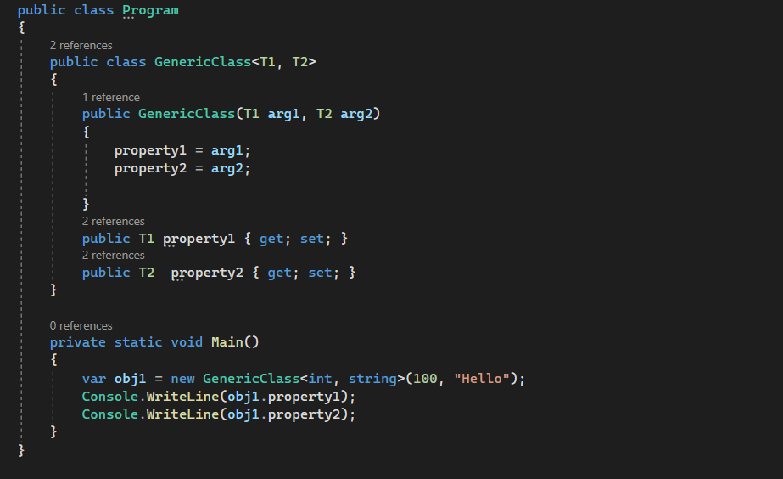

Slide 10
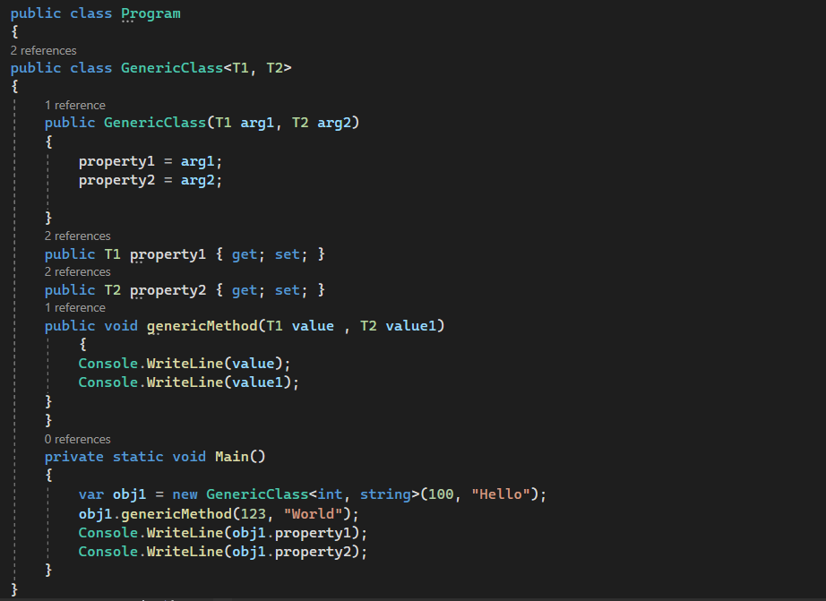

Slide 11
Generic Constraints
Constraints in C# are nothing but validations that we can put on the generic type parameter. That means constraints are used to restrict the types that can be substituted for type parameters. It will give you a compile-time error if you try to substitute a generic type using a type that is not allowed by the specified constraints. It is also possible to specify one or more constraints on the generic type using the where clause after the generic type name.
If we try to instantiate a generic class with the placeholder type, that is not allowed by a constraint, then the compiler will throw a compile-time error. For example, if we specify the generic type to accept on class type, then later if we try to send int, bool, or any value type, then we will get a compile-time error
Syntax: GenericTypeName<T> where T : contraint1, constraint2

Slide 12
Types of Generic Constraints
where T: struct => The type argument must be non-nullable value types such as primitive data types int, double, char, bool, float, etc. The struct constraint can’t be combined with the unmanaged constraint.
where T: class => The type argument must be a reference type. This constraint can be applied to any class (non-nullable), interface, delegate, or array type in C#.
where T: new() => The type argument must be a reference type that has a public parameterless (default) constructor.
where T: <base class name> => The type of argument must be or derive from the specified base class.
where T: <interface name> => The type argument must be or implement the specified interface. Also, multiple interface constraints can be specified.
where T: U => The type argument supplied for must be or derive from the argument supplied for U. In a nullable context, if U is a non-nullable reference type, T must be a non-nullable reference type. If U is a nullable reference type, T may be either nullable or non-nullable.

Slide 13
where T: class Generic Constraint
That means, now the GenericClass will only accept reference-type arguments. Let’s create an instance of the Generic class by passing reference-type arguments as follows. In C#, the string is a reference type.
GenericClass<string> stringClass = new GenericClass<string>();
The following statement will give you a compile-time error as int is a value type, not a reference type.
GenericClass<int> intClass = new GenericClass<int>();

Slide 14
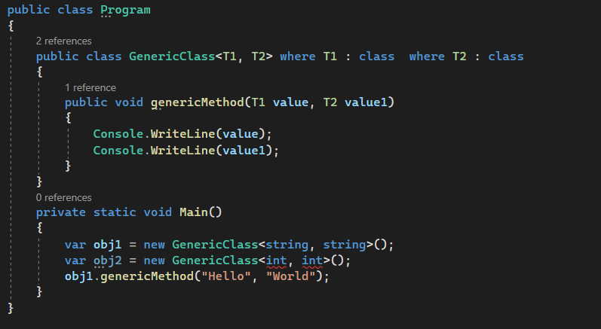

Slide 15
where T: struct Generic Constraint
If you want the type argument to accept only the value type then you need to use where T: struct constraints in C#. In this case, the type argument must be non-nullable value types such as int, double, char, bool, float, etc. The struct constraint can’t be combined with the unmanaged constraint. Let us see an example to understand where T: struct constraint.
That means, now the GenericClass will only accept value-type arguments. Let us create an instance of GenericClass by passing value-type arguments as follows.
GenericClass<int> intClass = new GenericClass<int>();
The following statement will give you a compile-time error as the string is a reference type, not a value type.
GenericClass<string> stringClass = new GenericClass<string>();

Slide 16
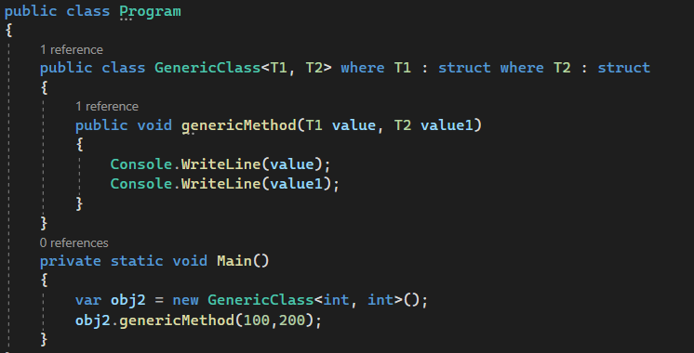

Slide 17
where T: BaseClass Generic Constraint
Here, the type of argument must be derived from the specified base class. That means in the <base class> constraint, we can only specify types that are inherited from <base class>. The following example shows the base class constraint that restricts the type argument to be a derived class of the specified class. For a better understanding, please have a look at the below example.
Employee is the derived class of the BaseEmployee class. On the other hand, Customer is not derived from the BaseEmployee class. Now, Let’s create an instance of GenericClass bypassing Employee type arguments as follows. It works fine because Employee is derived from the BaseEmployee class.
GenericClass<Employee> employee = new GenericClass<Employee>();
The following statement will give you a compile-time error as the Customer class is not derived from the BaseEmployee type.
GenericClass<Customer> customer = new GenericClass<Customer>();
Example to understand where T: BaseClass Constraint in C

Slide 18
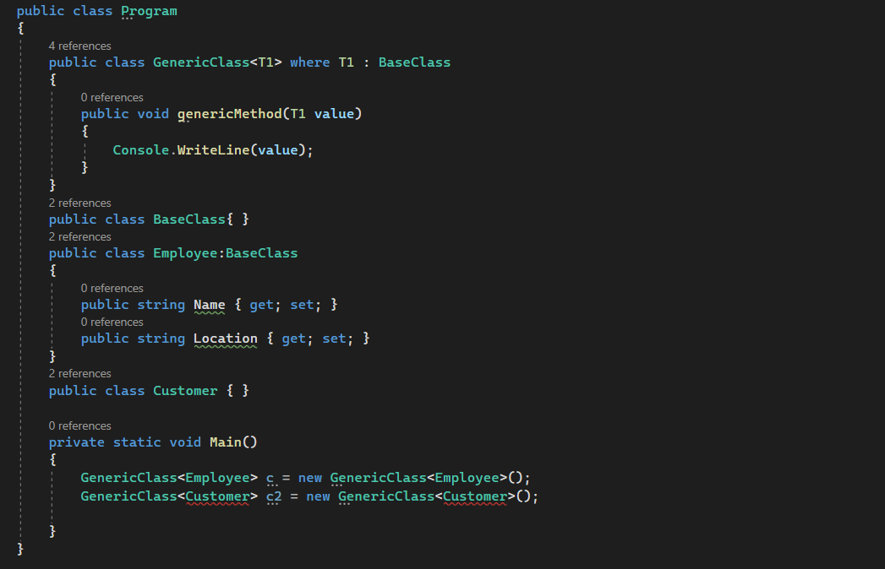

Slide 19
where T: new() Generic Constraint
Here, the type argument must be a reference type that has a public parameterless (default) constructor. That means with the help of the new() constraint, we can only specify types which has a parameterless constructor. For a better understanding, please have a look at the below example.
As you can see in the below code, we have not defined any constructor explicitly in the Employee class, so the compiler will provide a parameter-less default constructor. On the other hand, in the Customer class, we have defined one parameterized constructor explicitly. Now, Let us create an instance of GenericClass bypassing Employee type arguments as follows.
GenericClass<Employee> employee = new GenericClass<Employee>();
The following statement will give you a compile-time error as the Customer class has a Parameterized constructor or you can say the Customer class does not have a default parameterless constructor.
GenericClass<Customer> customer = new GenericClass<Customer>();.

Slide 20
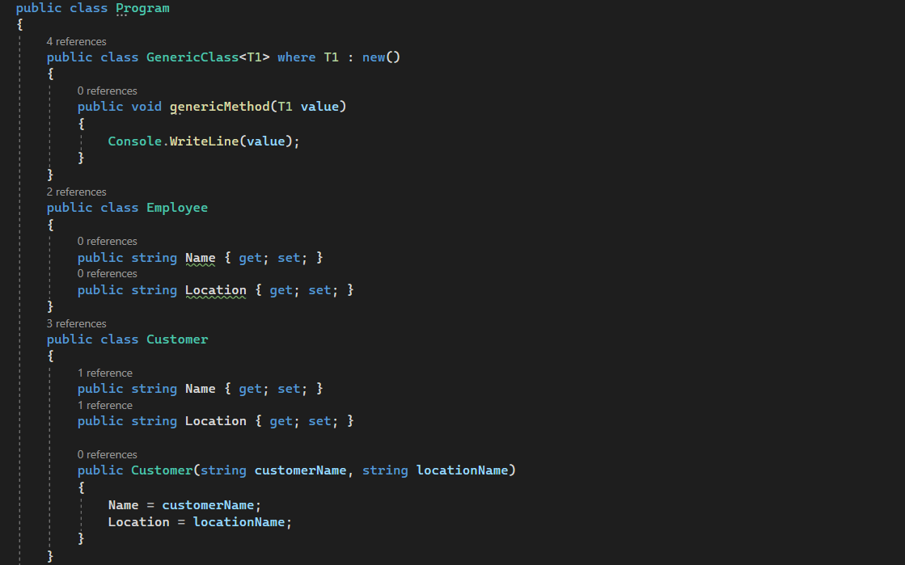
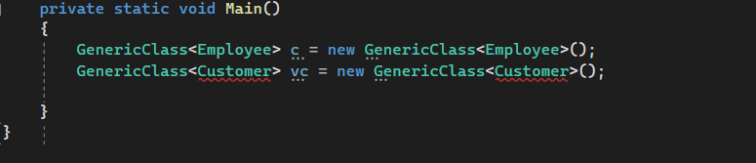

Slide 21
where T: Interface Generic Constraint
Here, the type argument must be or implement the specified interface. Also, multiple interface constraints can be specified. That means in the <interface> constraint, we can only specify types that implement the <interface>. For a better understanding, please have a look at the below example.
As you can see in the below code, the Employee class is implemented IEmployee interface. On the other hand, the Customer is not implementing the IEmployee interface. Now, let us create an instance of GenericClass bypassing Employee type arguments as follows. It works fine because the Employee class implements the IEmployee interface.
GenericClass<Employee> employee = new GenericClass<Employee>();
The following statement will give you a compile-time error as the Customer class does not implement the IEmployee interface.
GenericClass<Customer> customer = new GenericClass<Customer>();

Slide 22
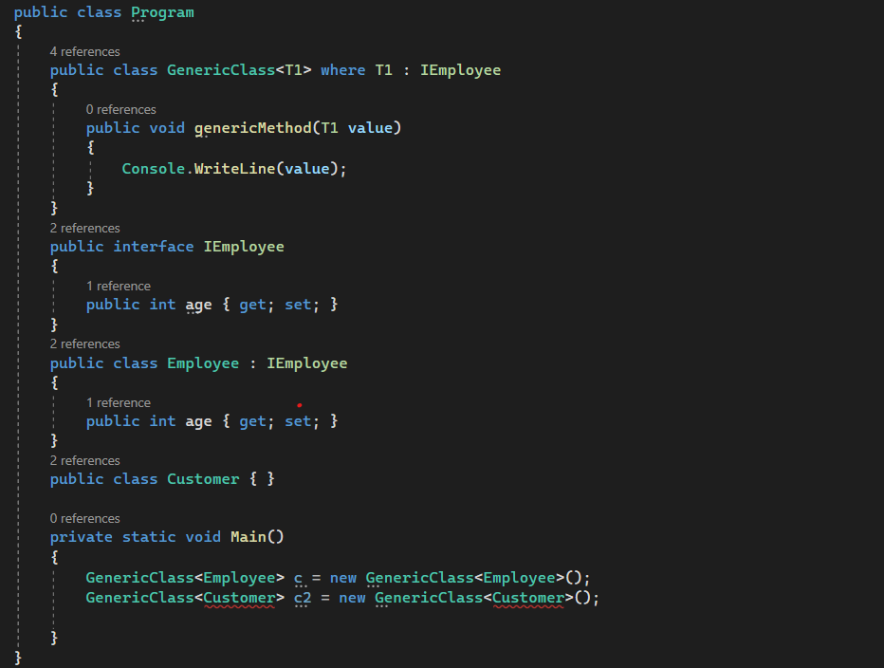

Slide 23
where T: U Generic Constraint
Here, the type argument supplied must be or derive from the argument supplied for U. In a nullable context, if U is a non-nullable reference type, T must be a non-nullable reference type. If U is a nullable reference type, T may be either nullable or non-nullable. So, in this constraint, there are two Type Arguments i.e. T and U. U can be an interface, abstract class, or simple class. T must inherit or implements the U class. For a better understanding, please have a look at the below code.
As you can see in the below code, the Employee class implements the IEmployee interface. On the other hand, the Customer class is not implementing the IEmployee interface. Now, Let’s create an instance of Genericclass bypassing Employee and IEmployee as type arguments for T and U as follows. It works fine because the Employee class implements the IEmployee interface.
GenericClass<Employee, IEmployee> employeeGenericClass = new GenericClass<Employee, IEmployee>();
The following statement will give you a compile-time error as the Customer class does not implement the IEmployee interface i.e. T does not implement U.
GenericClass<Customer, IEmployee> customerGenericClass = new GenericClass<Customer, IEmployee>();

Slide 24
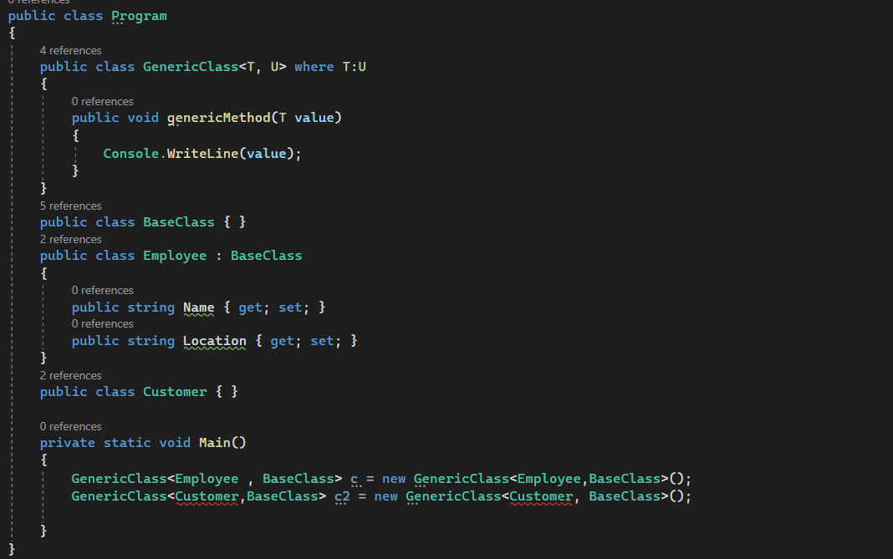

Slide 25
